Slide 1
LITERATURE REVIEW A SAT-based System for Consistent Query Answering
Amrutham Lakshmi Himaja
- Atharva Kadam
- Saikrishna Rachha
- Shivcharan Bharathi

Slide 2
INTRODUCTION
To manage the inconsistency of the database and finding a apt approach for it.
To address breaches of integrity requirements in a given inconsistent database data cleaning, clustering techniques, and/or domain knowledge are applied, resulting in a single consistent database.
This paper proposes a CAvSAT system (consistent answers via SAT).

Slide 3
PROBLEM STATEMENT
Computing the consistent replies of a fixed conjunctive query on a given inconsistent database can be a coNP-hard task., a SAT-based method for consistent query responding.
Unions of conjunctive questions and arbitrary denial restrictions may be handled by the system, which includes functional dependencies as a specific instance.
Experiments testing CAvSAT on both synthetic and real-world datasets are presented.

Slide 4
METHODOLOGY
Arenas, Bertossi, and Chomicki developed a framework of database repairs and consistent query response and more principled, method to data cleansing.
Computing consistent answers to a query on the database can be computationally more difficult than assessing.
The EQUIP system employs binary integer programming reductions and the subsequent deployment of CPLEX.
There is currently no complete and scalable system for consistent query answering.
This hampered the widespread acceptance of the framework of repairs and consistent responses as a principled alternative to data cleansing.

Slide 5
INCONSISTENT DATABASES
Inconsistent database: database that violates given integrity constraints.
Some reasons for database to be inconsistent:
- DBMS does not enforce all ICs. - Integration of data from different databases. - New constraints are imposed on pre existing database. - Soft or user constraints.
In several cases we don’t want to repair database to restore consistency:
- no permission. - too expensive. - temporary inconsistency.

Slide 6
TECHNIQUES TO SOLVE INCONSISTENCIES
DATA CLEANING
Clustering techniques and/or domain knowledge are used to resolve violations of integrity constraints.
The framework of database repairs and consistent query answering are principle approach to data cleaning.
Inconsistencies are handled at query time by considering all possible repairs of the inconsistent database I is a consistent database J that differs from I in a “minimal” way.
Modifying (adding, deleting, updating) the tuples in relations removes discrepancies. - We don't obtain this via data cleaning; regardless of how the database is repaired, the consistent responses will remain the same.
DATABASE REPAIRS
Deals with inconsistencies in databases without having to clean up dirty data.
In an inconsistent database, repair is the most consistent subset of that dataset.

Slide 7
PROPOSED APPROACH
Identification of the problem
Managing inconsistencies in databases is a challenge that arises in several different contexts.
Analyzing the problem
Preliminary stand-alone evaluation of CAvSAT on both synthetic and real-world databases.
The first set of tests focused on providing consistent replies to conjunctive queries under key constraints on synthetic databases with up to one million tuples per relation.
The consistency of replies to (unions of) conjunctive queries under functional dependencies was the focus of the second set of tests.

Slide 8
PROPOSED APPROACH
Developed solution
Natural reductions from the complement of consistent query responses to SAT and to WEIGHTED MAXSAT are used by the CAvSAT system.
Handling the consistent replies to unions of conjunctive queries under denial constraints, a type of integrity constraint that includes functional dependencies (also, key constraints).
Findings / Results
First, Comparing the performance of CAvSAT against the FO-rewritings over the database with primary key constraints.
In the second scenario, we evaluated the performance of CAvSAT on a real-world database with functional dependencies.
CAvSAT had comparable or even better performance to evaluating the first-order rewritings using a database engine, such as PostgreSQL.

Slide 9
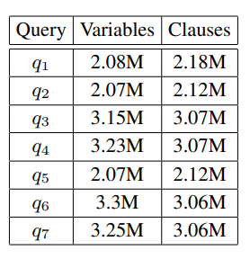
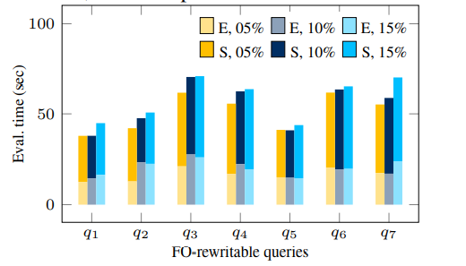
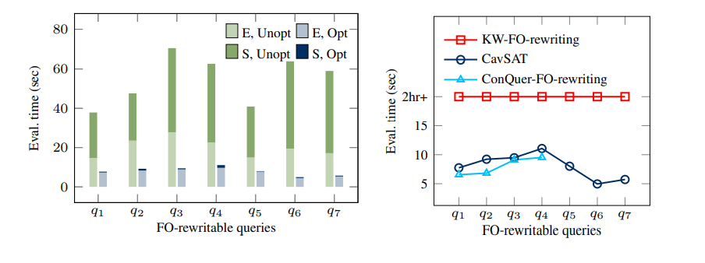
CAvSAT ON FO-REWRITABLE QUERIES

Slide 10
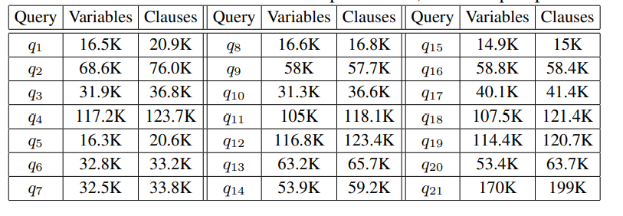
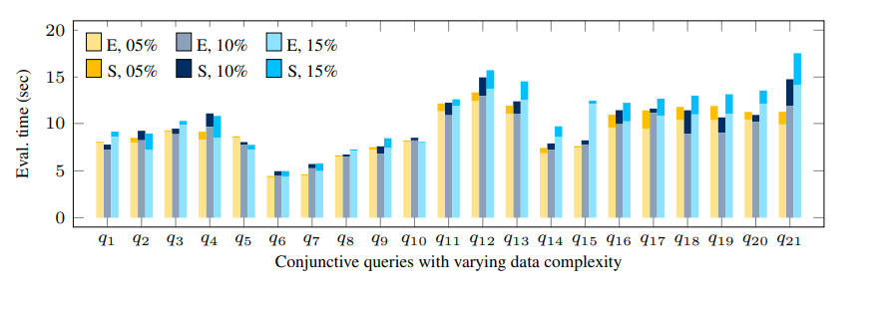
CAvSAT ON HARDER QUERIES

Slide 11
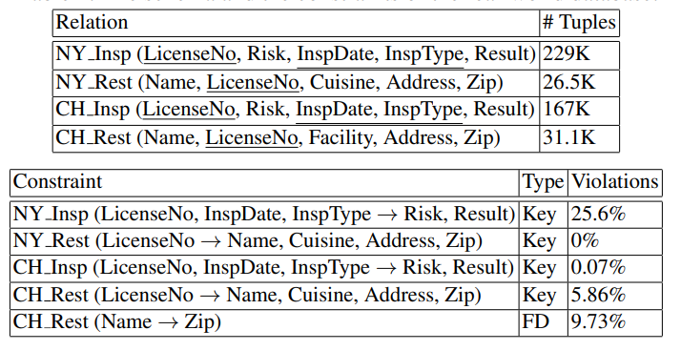
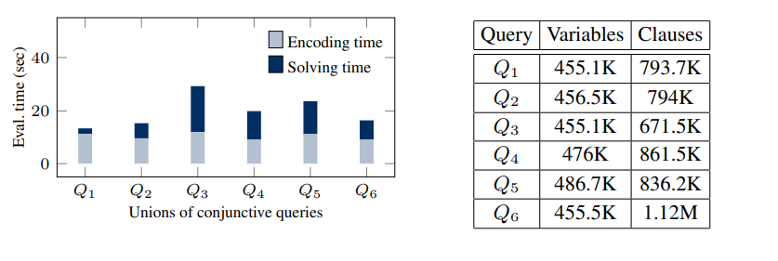
RESULTS ON THE REAL-WORLD DATABASES

Slide 12
CONCLUSION
CAVSAT fared as good as or better than using a database engine to evaluate first-order rewritings on queries with first-order rewritable consistent responses.
This result reveals a potential difference between theory and practice because the examination of first-order writability of consistent responses was motivated by the need for an efficient evaluation of consistent answers using only the database engine.
The experimental findings reported here provide evidence that a SAT-based approach can indeed give rise to a comprehensive and scalable system for consistent query answering.

